Slide 1




NEXT GEN EMPLOYABILITY PROGRAM
Creating a future-ready workforce
Team Members
College Name
Student Name : Chokka Venkateswarlu
Student ID : 721121104005
Study World College of Engineering

Slide 2

CAPSTONE PROJECT SHOWCASE
Project Title
Notes Sharing Web Application using Django Framework
Abstract | Problem Statement | Project Overview | Proposed Solution | Technology Used | Modelling & Results | Conclusion

Slide 3
Abstract
ShareNote is a dynamic web application designed to facilitate seamless collaboration and efficient sharing of notes among users. With the increasing demand for digital tools that enhance productivity and collaboration, ShareNote emerges as a solution to streamline the process of sharing and managing notes across various users and devices.
The application offers a user-friendly interface that allows individuals to create, edit, organize, and share their notes effortlessly. Users can create personalized accounts to access their notes securely from anywhere, at any time. ShareNote prioritizes user privacy and security by implementing robust authentication and authorization protocols.
Source :

Slide 4
Problem Statement
In today's fast-paced digital landscape, individuals, teams, and organizations face significant challenges in efficiently sharing, collaborating on, and managing notes. Traditional methods of note-taking often lack the flexibility, accessibility, and collaboration features required to meet modern productivity demands. There is a growing need for a comprehensive notes sharing web application that addresses these challenges and provides users with a seamless and secure platform for creating, editing, sharing, and organizing notes collaboratively across various devices and environments.
Source :

Slide 5
Project Overview
User-friendly Interface: ShareNote offers an intuitive and user-friendly interface that makes note-taking and collaboration effortless for users of all skill levels.
Real-time Collaboration: ShareNote enables real-time collaboration, allowing multiple users to edit and contribute to the same note simultaneously. This feature fosters teamwork and enhances productivity in educational, professional, and personal settings.
Security and Privacy: ShareNote prioritizes user security and privacy by implementing robust authentication and authorization protocols, ensuring that users maintain control over their shared content and data.
Cross-platform Compatibility: ShareNote is accessible across various devices and operating systems, including desktop computers, laptops, tablets, and smartphones. This ensures that users can access their notes seamlessly regardless of their preferred device.
Advanced Search and Organization: ShareNote offers robust search functionality and organizational tools, allowing users to quickly locate specific notes or topics within their collection and efficiently manage their notes using tags, keywords, or custom filters.
Offline Access and Synchronization: ShareNote provides offline access to notes, enabling users to view and edit their content even without an internet connection. Synchronization occurs automatically once the user's device reconnects to the internet, ensuring that changes are seamlessly updated across all devices.
Source :

Slide 6
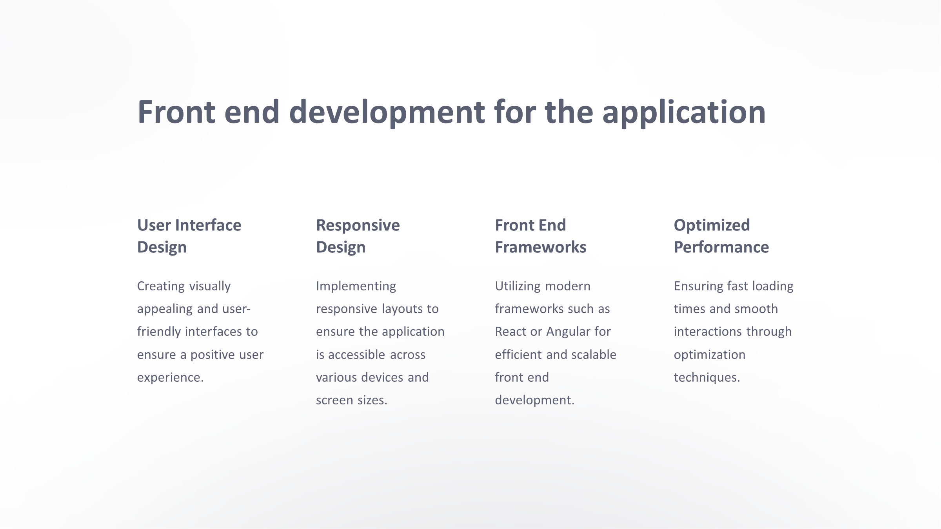
Proposed Solution
.
Source :

Slide 7
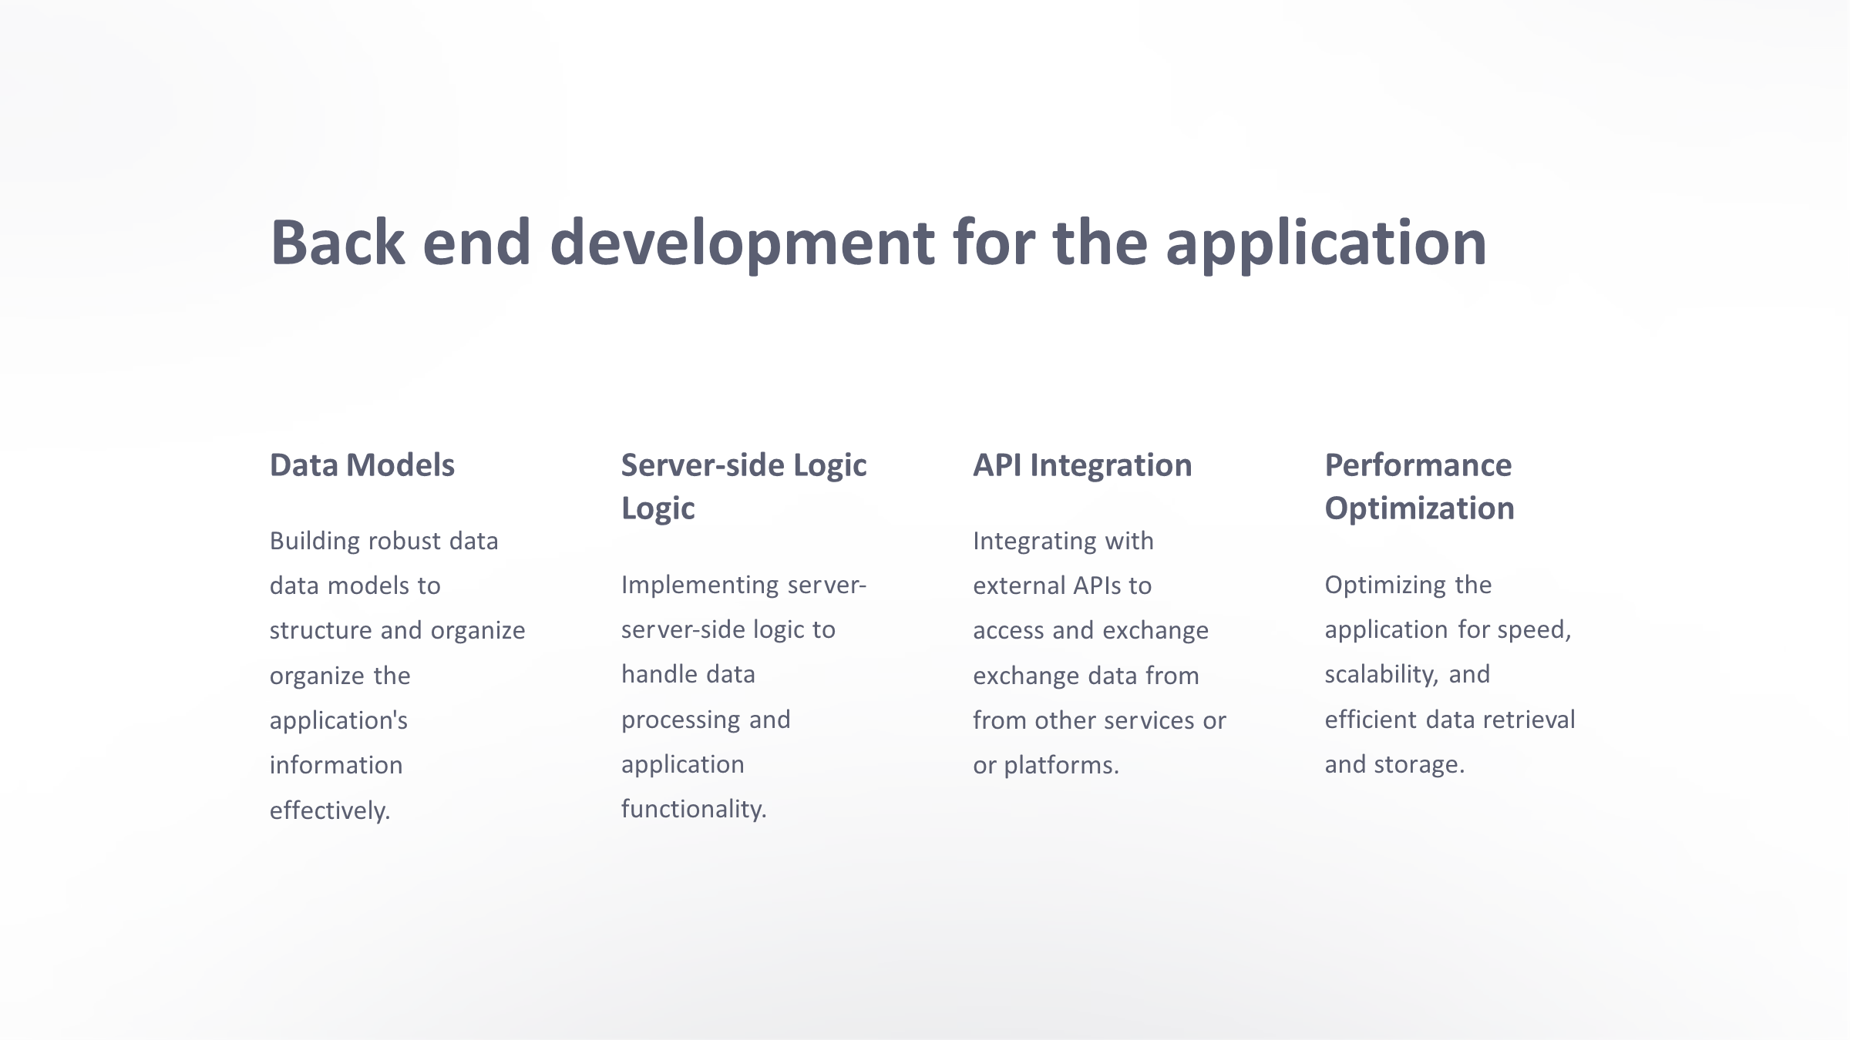
Source :

Slide 8
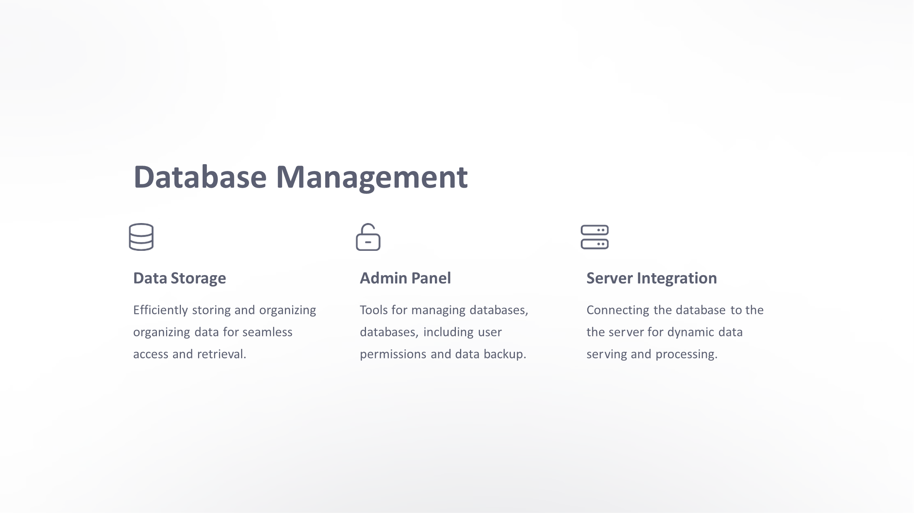
Source :

Slide 9


Technology Used
Front-end
Back-end
Source :

Slide 10
Modelling & Results
Modelling:
There are two main aspects to consider when modelling:
Data Model: This defines the structure of information stored in your application. Key elements include:
Users: User accounts with details like username, password, email etc.
Notes: Information about each note - title, content, creation date, etc. Consider options for rich text formatting, images, or attachments.
Sharing: Define how notes are shared - publicly, with specific users, or groups.
Permissions: Control access levels (read, edit, comment) for different users on shared notes.
Additional Features: Depending on your vision, consider tags, categories, version history, or integrations with other tools.
Functional Model: This outlines the application's functionalities:
User Management: User registration, login, profile management.
Note Creation & Editing: Users can create new notes, edit existing ones.
Sharing & Permissions: Implement functionalities for sharing notes and setting access levels.
Search & Filtering: Allow users to search for notes based on keywords, tags, or other criteria.
Results:
A successful notes sharing web application can lead to:
Improved Collaboration: Teams can share notes, ideas, and information efficiently.
Enhanced Productivity: Users can organize information, access notes from anywhere, and potentially collaborate in real-time.
Knowledge Sharing: Facilitate sharing best practices, procedures, or other valuable information within an organization or community.
Scalability: The application can grow with the user base, accommodating increasing data and users.
Source :

Slide 11
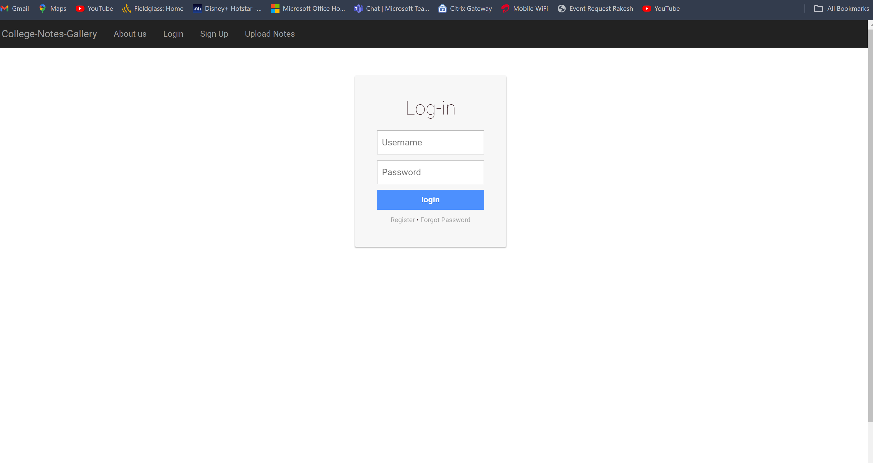
Homepage

Slide 12
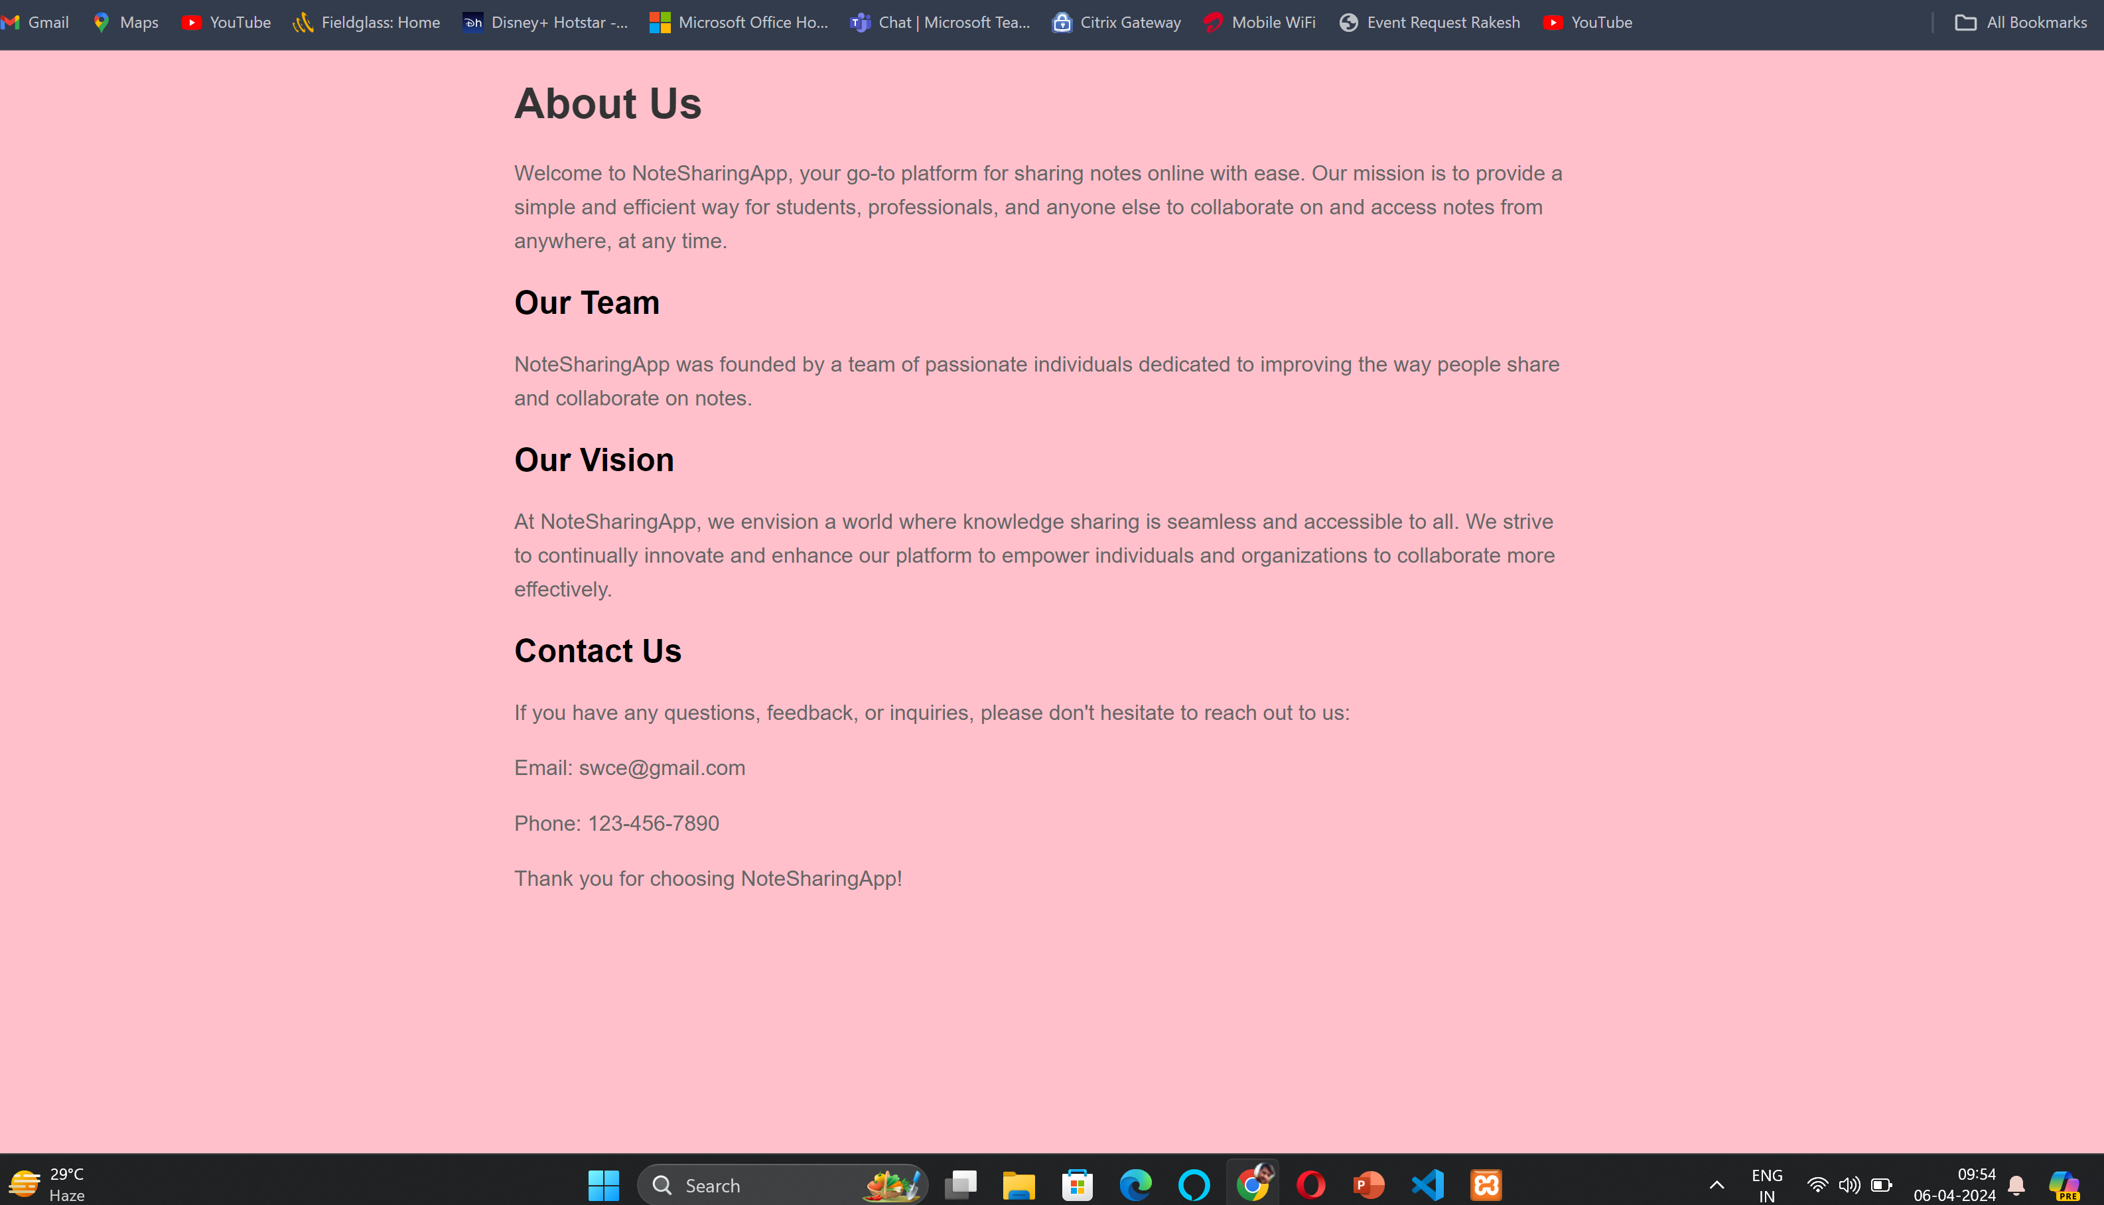
About-Us-Page

Slide 13
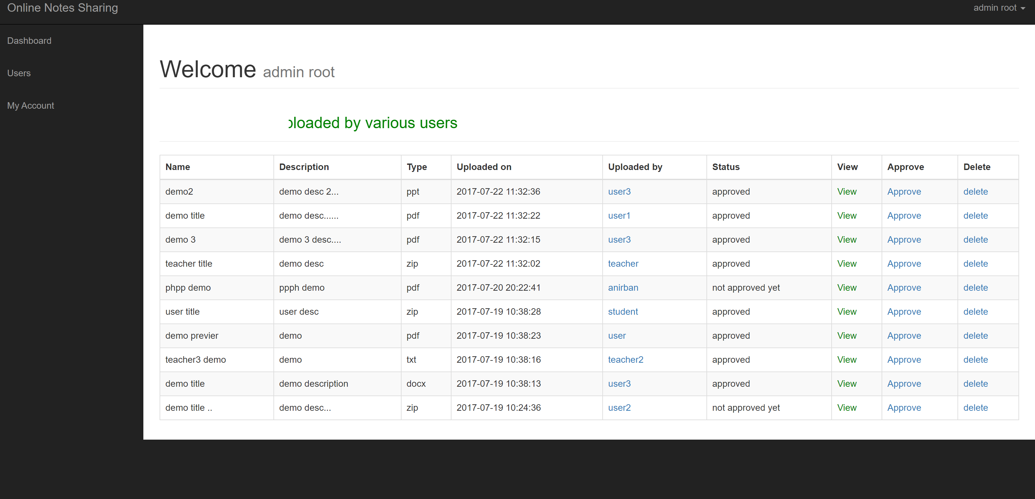
Service-Page

Slide 14
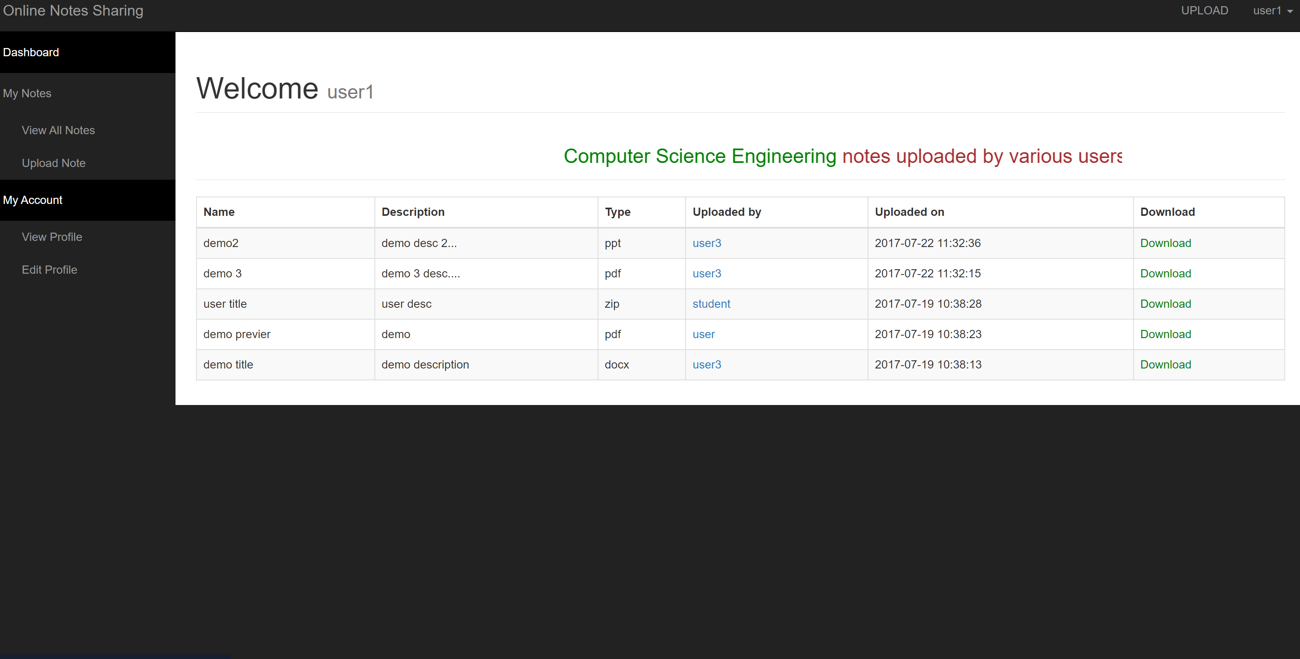
Departments-Page

Slide 15
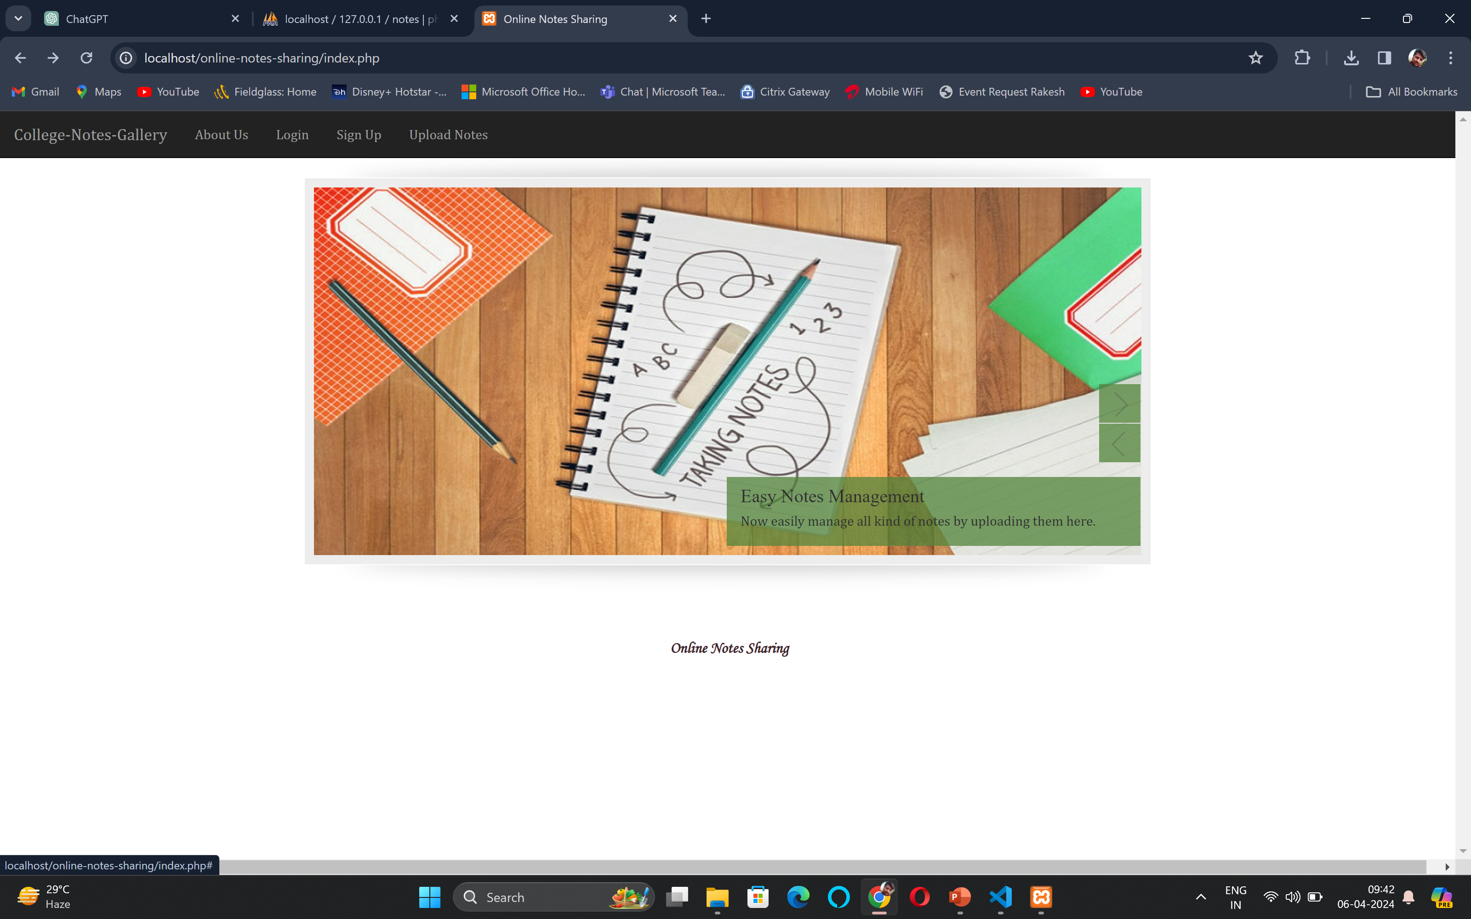
Blog-Page

Slide 16
Future Enhancements:
Real-Time Collaboration: Implementing real-time collaborative editing features similar to Google Docs, where multiple users can edit and view notes simultaneously. This would involve integrating live syncing and version control to ensure smooth collaboration.
Advanced Search and Organization: Enhancing search capabilities with filters, tags, and categories to help users easily find and organize their notes. Implementing AI-driven suggestions for tags based on note content could further streamline organization.
Integration with Productivity Tools: Integrating with popular productivity tools such as task managers, calendars, and project management software to enable seamless workflow management. This could include features like automatically creating tasks from notes or syncing notes with calendar events.
Enhanced Security Features: Implementing end-to-end encryption for notes to ensure data privacy and security. Additionally, adding features such as two-factor authentication and access controls to manage permissions for sharing and editing notes.
Offline Access and Syncing: Developing robust offline functionality that allows users to access and edit their notes even without an internet connection. Notes created or edited offline would automatically sync with the cloud when the user regains connectivity.

Slide 17
Conclusion
This concludes the overview of the note sharing web application using Django. In the future,enhancements could include advanced user permissions, real-time collaboration, and integration with cloud storage services.
As the application grows, additional features such as version control, user activity tracking, and mobile app development could further improve the user experience and functionality.
Source :

Slide 18
Thank You!
Notes:
Thank You !!

